Slide 1
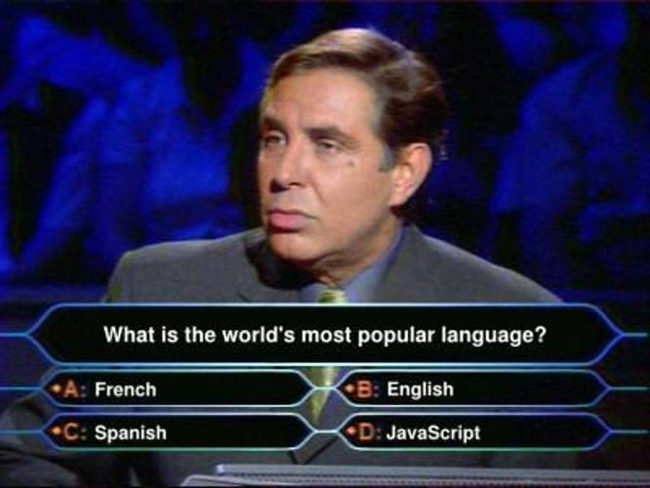

Slide 2
JavaScript introduction
JavaScript is a scripting language for the web.
It was developed to introduce interactivity into HTML pages.
As it builds interactive webpages, so it is an essential part of the web application

Slide 3
Javascript introduction contd….
It is loosely typed.
It runs in the JavaScript engine in the browser.
JavaScript engines were originally used only in web browsers, but they are now core components of other software systems, most notably servers and a variety of applications.

Slide 4
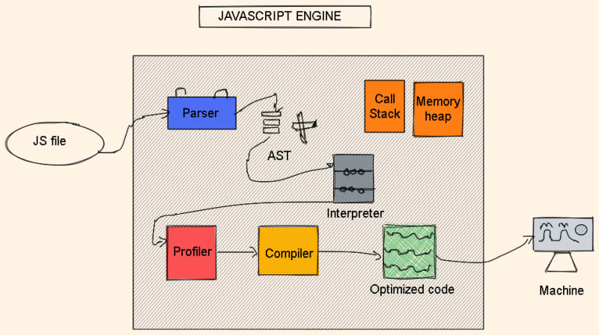
How javascript engine works

Slide 5
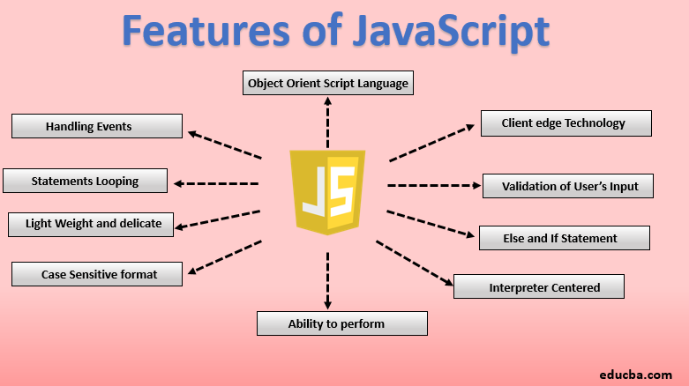
Now let’s discuss about its features

Slide 6
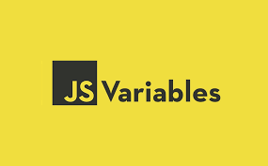

Slide 7
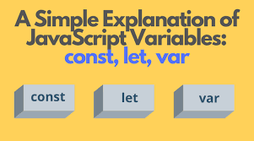
Difference between all the three

Slide 8
JavaScript variables
variables are the entities that hold the data value and it can be changed anytime.
It is like a container for a value
For example:
let a=10

Slide 9
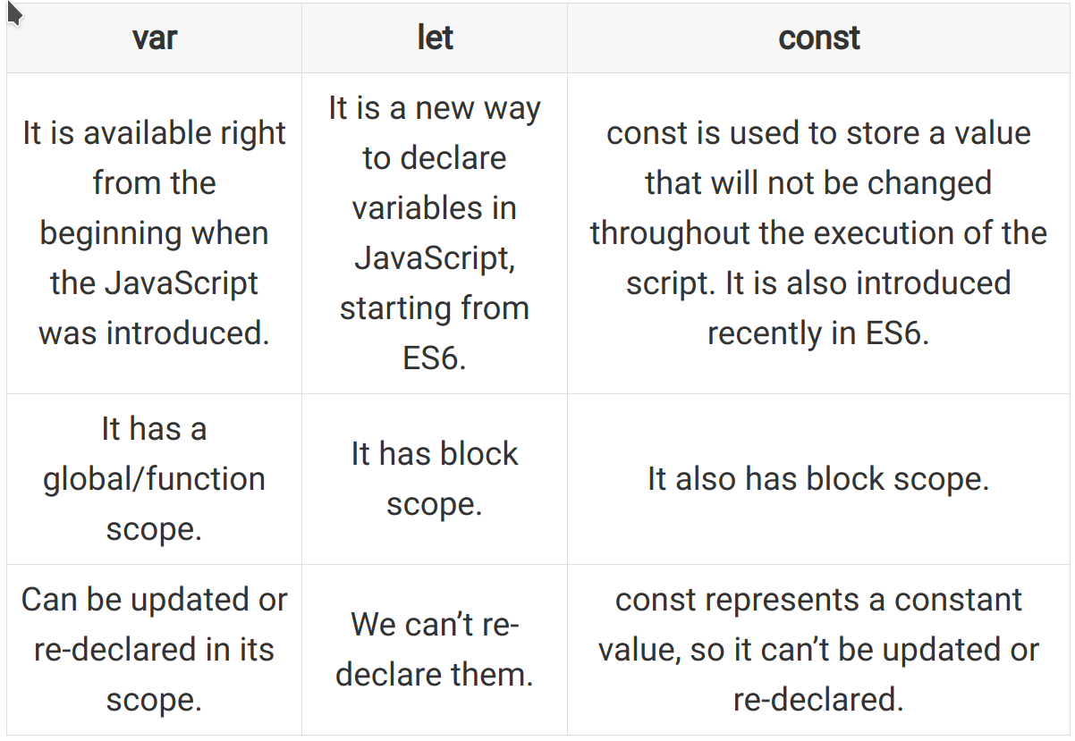

Slide 10
Answer this
What is the default value of an uninitialized variable in JavaScript?
a. 0
b. null
c. undefined
d. "undefined"

Slide 11
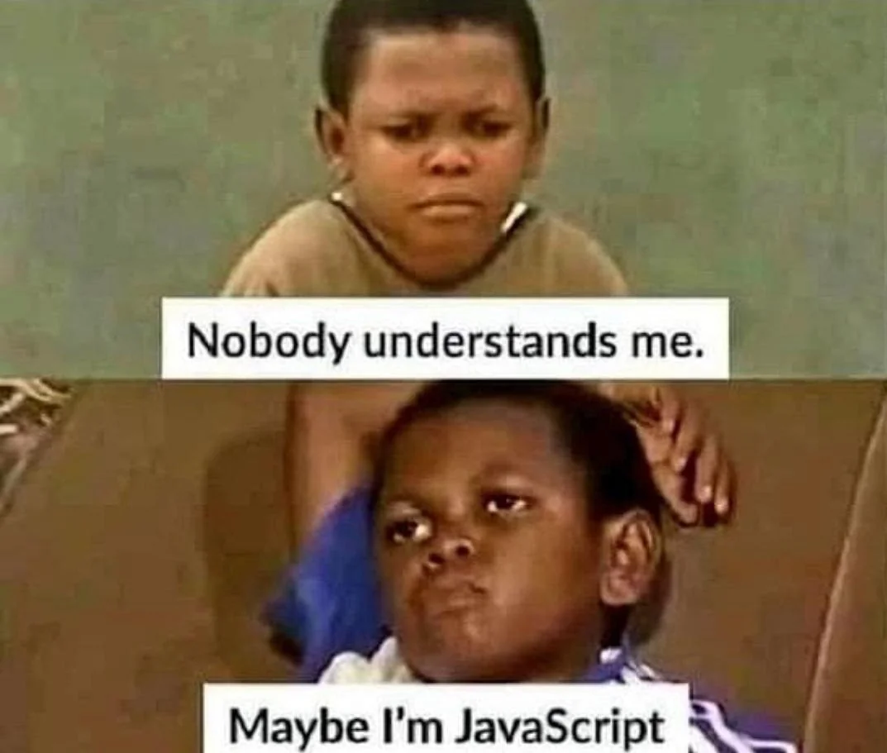

Slide 12
Data types in JavaScript
It is one of the most important topics of javascript.
To be able to operate on variables, it is important to know about the type of data we are using.

Slide 13
Dynamic typing
JavaScript is a loosely typed and dynamic language.
It means we do not have to explicitly define the type of data that is used in javascript.
It is understandable by the language itself.

Slide 14
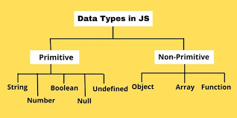
Data types in javascript

Slide 15
Primitive data types
in JavaScript, primitive data types are basic types that represent single values. They are immutable, meaning their values cannot be changed
Now we will discuss the primitive datatype:
String: it represents the data in textual format.
Var name=“mamta”

Slide 16
Primitive data types
Number:
Represents numeric values, including integers and floating-point numbers.
var age = 25;
var f= 3.14;
Javascript numbers are always one type i.e. double (64-bit floating point)
Boolean:
var isAdult = true;

Slide 17
Concept of bigint:
All JavaScript numbers are stored in a 64-bit floating-point format.
JavaScript BigInt is a new datatype that can be used to store integer values that are too big to be represented by a normal JavaScript Number.
For ex: let x = BigInt("123456789012345678901234567890");
JavaScript integers are only accurate up to 15 digits.

Slide 18
Primitive data types
Null type
The Null type has exactly one value: null.
var nullValue = null;
Undefined type
A variable that has not been assigned a value has the value undefined.
var undefinedVariable;

Slide 19
Primitive data types
Symbol
Symbol is a built-in object whose constructor returns a symbol primitive — also called a Symbol value or just a Symbol — that’s guaranteed to be unique.
Symbols are often used to add unique property keys to an object that won’t collide with keys any other code might add to the object, and which are hidden from any mechanisms other code will typically use to access the object.

Slide 20
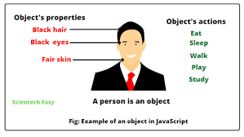
Objets in javascript

Slide 21
Objects
An object is a standalone entity, with properties and type. It stores related information of an entity. In JavaScript, objects can be seen as a collection of properties.
const class={name:”abc”, roll no:1}
Accessing the elements of an object:
We can access the properties of an object in two ways:
objectName.propertyName
objectName["propertyName"]

Slide 22
Arrays
An array is a single variable that is used to store different elements. Unlike most languages where an array is a reference to the multiple variable.

Slide 23
operators
Types of JavaScript Operators
There are different types of JavaScript operators:
Arithmetic Operators
Assignment Operators
Comparison Operators
String Operators
Logical Operators
Bitwise Operators
Ternary Operators
Type Operators

Slide 24
Arithmetic operators
Arithmetic Operators are used to perform arithmetic on numbers
let a = 5; let x = a* a;
Assignment operators
Assignment operators assign values to JavaScript variables.
let x = 10; x += 5;

Slide 25
Comparison Operators
JavaScript String Comparison:
All the comparison operators above can also be used on strings:
let text1 = “mamta"; let text2 = “sharma"; let result = text1 < text2;
We have to concatenate the two strings by using + symbol
let text1 = "John"; let text2 = "Doe"; let text3 = text1 + " " + text2;

Slide 26
Loops
Loops can execute a block of code several times.
JavaScript supports different kinds of loops:
For loop
While loop
Do while loop
For in loop
For of loop

Slide 27
Functions:
Functions
A set of statements that performs a task or calculates a value
A JavaScript function is a block of code designed to perform a particular task.
A JavaScript function is executed when "something" invokes it (calls it).

Slide 28
A function definition (also called a function declaration, or function statement) consists of the function keyword, followed by:
The name of the function.
A list of parameters to the function, enclosed in parentheses and separated by commas.
The JavaScript statements that define the function, enclosed in curly braces, { /* … */ }

Slide 29
Ways to declare a function
A function can be anonymous i.e. not having a name
const square = function (number) {
return number * number;
};
console.log(square(10));

Slide 30
2nd method
const factorial = function fac(n) {
return n < 2 ? 1 : n * fac(n - 1);
};
console.log(factorial(3));

Slide 31
Arrow function
Arrow functions allow us to write shorter function syntax:
leghtght myFunction = (a, b) => a * b;
Before Arrow:
hello = function() { return "Hello World!"; }
With Arrow Function:
hello = () => { return "Hello World!"; }

Slide 32
Arrow function with no parameters
const greet = () => console.log("Hello!");
Arrow function with one parameter
const square = x => x * x;
Arrow function with multiple parameters
const multiply = (a, b) => a * b;
Arrow function with block statement
const greetWithName = (name) => {
console.log(`Hello, ${name}!`);
console.log("Welcome to the program.");
};

Slide 33
Error handling
Errors can be coding errors made by the programmer, errors due to wrong input, and other unforeseeable things.

Slide 34
Callback in javascript
a callback is a function that is passed as an argument to another function and is executed after the completion of some asynchronous operation or at a specified time.
Callbacks are a fundamental concept in JavaScript, especially in handling asynchronous operations.
In Node.js, callbacks are a standard mechanism for handling asynchronous operations, like reading files, making network requests, or handling database queries

Slide 35
const numbers = [1, 2, 3, 4, 5, 6, 7, 8, 9, 10];
function filterEven(arr, callback) {
const filtered = arr.filter(callback);
console.log(filtered);
}
filterEven(numbers, function (num) {
return num % 2 === 0;
});

Slide 36
Error handling in js
An error is an action that is inaccurate or incorrect. There are three types of errors in programming which are discussed below:
Syntax error
Logical error
Runtime error

Slide 37
Syntax error
a syntax error is an error in the syntax of a sequence of characters or tokens,
it is also a compile-time error if the syntax is not correct then it will give an error message.

Slide 38
Logical error
it is the error on the logical part of the coding or logical error is a bug in a program that causes it to operate incorrectly and terminate abnormally (or crash)

Slide 39
Runtime error
A runtime error is an error that occurs during the running of the program, also known as the exception.

Slide 40
try-catch method
JavaScript uses the try catch and finally to handle the exception and it also uses the throw operator to handle the exception. try have the main code to run and in the catch block if any error is thrown by try block will be caught and the catch block will execute. Finally block will always occur even if an error is thrown

Slide 41
One error in JavaScript onerror is a special browser event that fires whenever an uncaught JavaScript error has been thrown. It’s one of the easiest ways to log client-side errors and report them to your servers.

Slide 42
The onerror event handler provides three pieces of information to identify the exact nature of the error −
Error message − The same message that the browser would display for the given error
URL − The file in which the error occurred
Line number− The line number in the given URL that caused the error

Slide 43
syntax
window.onerror = function (msg, url, line)
{

Slide 44
Events
change in the state of an object is known as an Event
When javascript code is included in HTML, js react over these events and allow the execution.
This process of reacting over the events is called Event Handling.
Thus, js handles the HTML events via Event Handlers

Slide 45
JavaScript onclick events: This is a mouse event and provokes any logic defined if the user clicks on the element it is bound to.
<html>
<head>
<script>
function hiThere() {
alert('Hi there!');
}
</script>
</head>
<body>
<button type="button“, onclick="hiThere()“>
Click me event
</button>
</body>
</html>

Slide 46
onmouseover event: This event corresponds to hovering the mouse pointer over the element and its children, to which it is bound to.
JavaScript onkeyup event: This event is a keyboard event and executes instructions whenever a key is released after pressing.

Slide 47
eventlistners

Slide 48
timers
These time intervals are called timing events
The two key methods to use with JavaScript are:
SetTimeout(function,milliseconds):
Executes a function, after waiting a specified number of milliseconds.
b) setInterval(function,milliseconds):
Same as setTimeout(), but repeats the execution of the function continuously

